Slide 1
Two Problems involving Square Numbers

Slide 2
Malvern United Football Club have 18 squad members. Each player is numbered from 1 to 18.
At training they all wear their squad numbers and have to train with a partner. The coach is a keen mathematician and sets the following rule:
The two partner’s squad numbers must add up to a square number.
Everyone has a partner.
Your challenge is to find which numbers must be paired up.

Slide 3
The solution is …
1 and 15
2 and 14
3 and 13
4 and 12
5 and 11
6 and 10
7 and 18
8 and 17
9 and 16

Slide 4
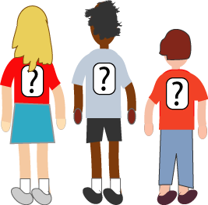

Mrs Morgan, the class's teacher, pinned numbers onto the backs of three children: Mona, Bob and Jamie.
"Now", she said, "Those three numbers add to a
special kind of number. What is it?"
Michael put his hand up.
"It's a square number", he answered.
"Correct", smiled Mrs Morgan.
"Oh!" exclaimed Mona, "The two numbers I can see also add to a square!“
"And me!" called out Bob, "The two numbers I can see add to a square too!“
"Oh dear", said Jamie disappointedly, "the two numbers I can see don't add to a square! It's either 5 too little or 6 too big!“
What numbers did the three children have on their backs?
Every number is less than 40 including the square numbers

Slide 5
The solution is …
Jamie’s answer indicates that Mona and Bob’s numbers add up to 31, so the other number must be 5 to make 36.
So Jamie = 5
If Mona = x and Bob = y
Then x + 5 = square number
y + 5 = square number
And x + y = 31
Mona = 11
Bob = 20
Or Bob = 11 and Mona = 20

